Slide 1
Welcome.
Norwegian University of Science and Technology
Prof. Dr. Anne Neumann
XIX Conference of the Spanish Association for Energy Economics, 2024 (Granada, Spain)

Slide 2

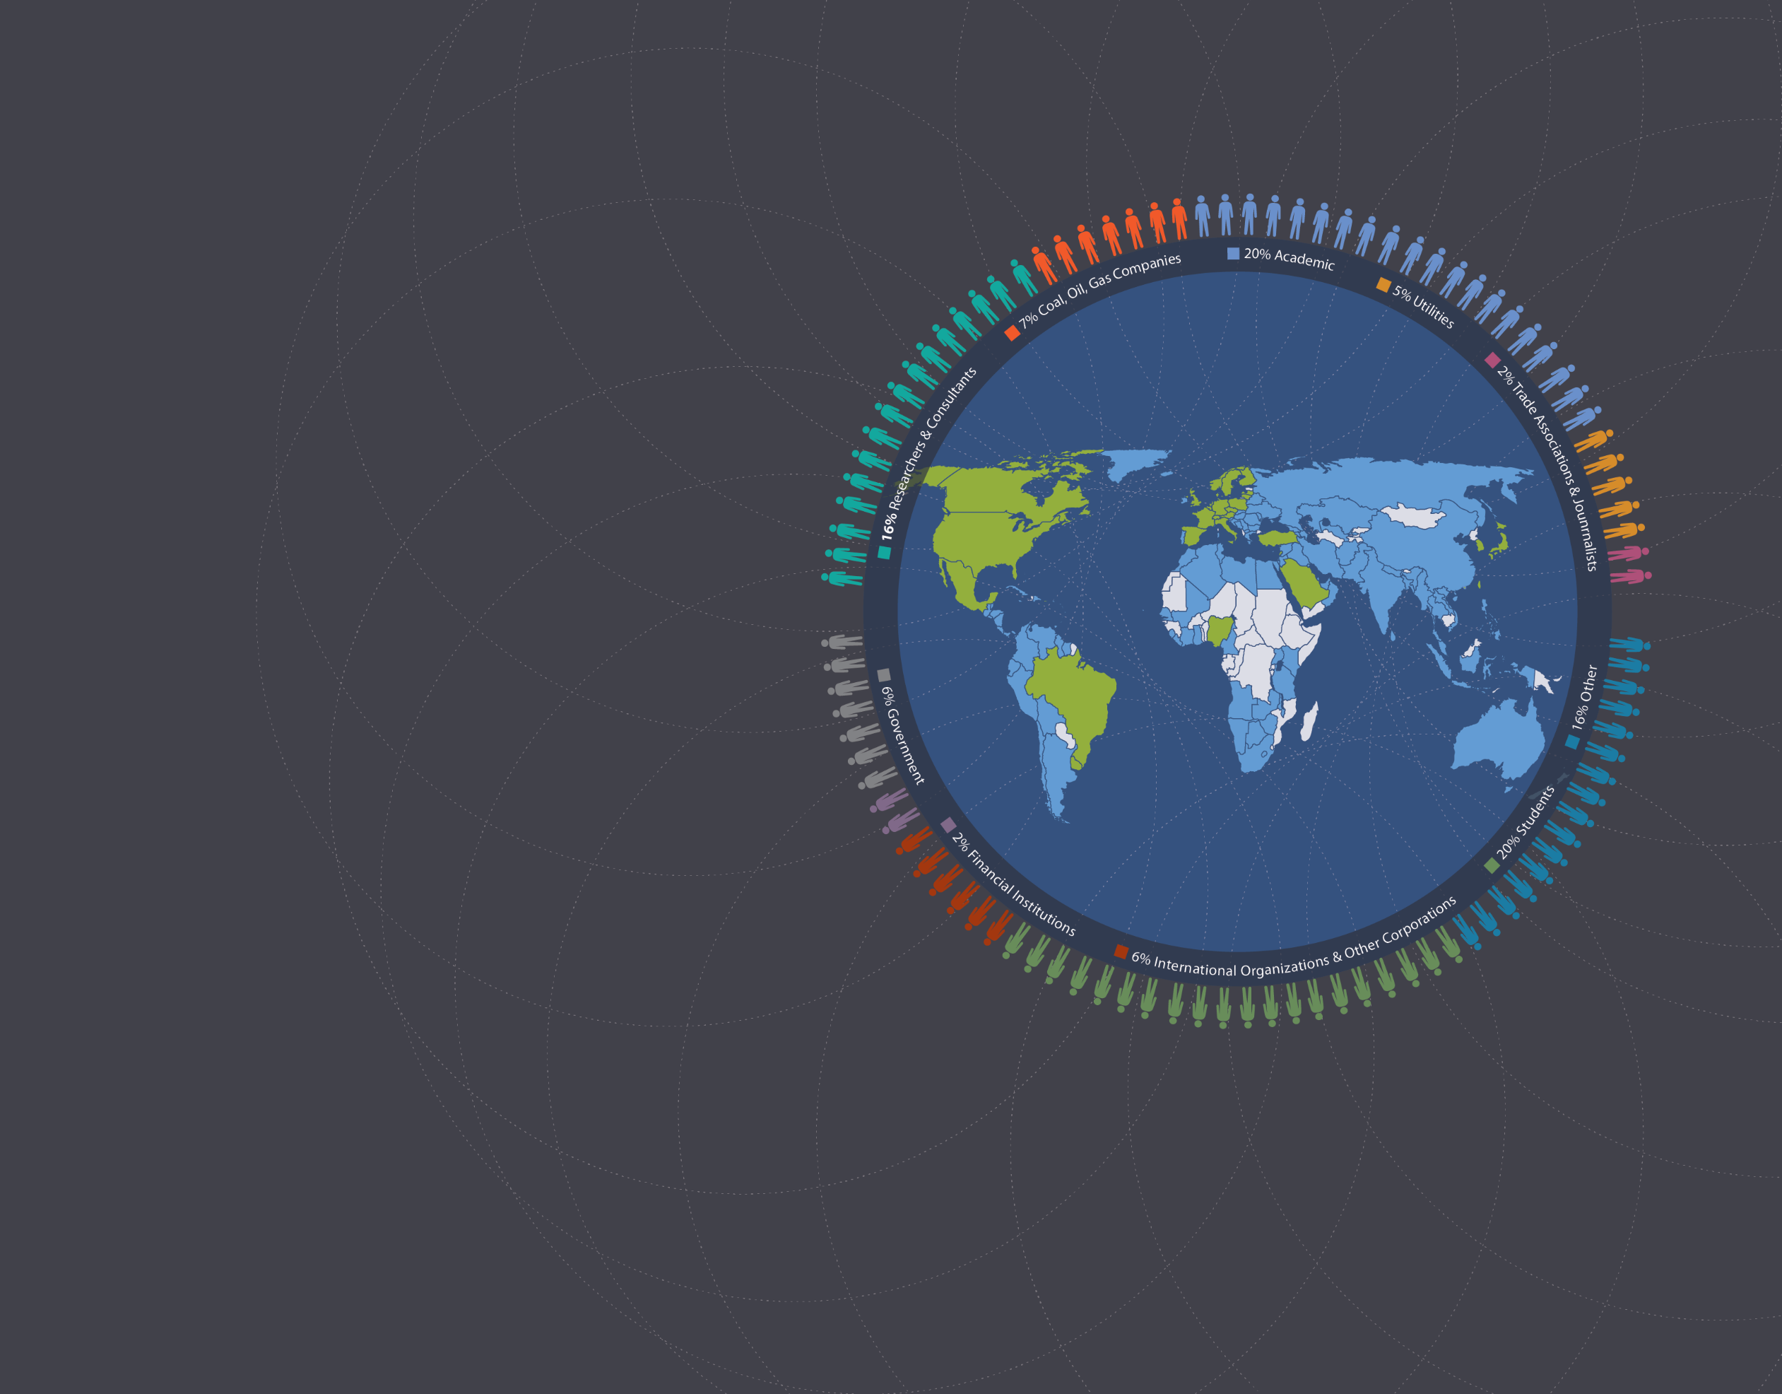
3,750+ members in over 110 countries
1,600 Europe
550 North America
850 Asia, Africa, Latin America & Middle East
3,750+ Members
30 International Affiliates
110 Countries represented
30 International Affiliates
Notes:
2

Slide 3
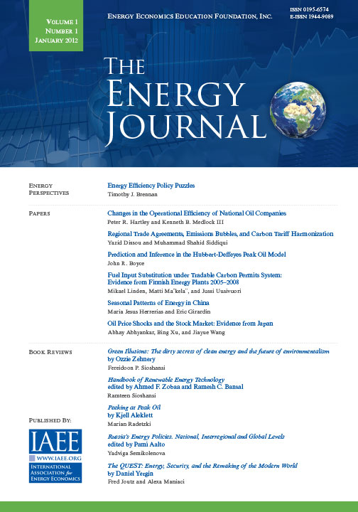
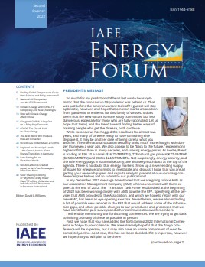
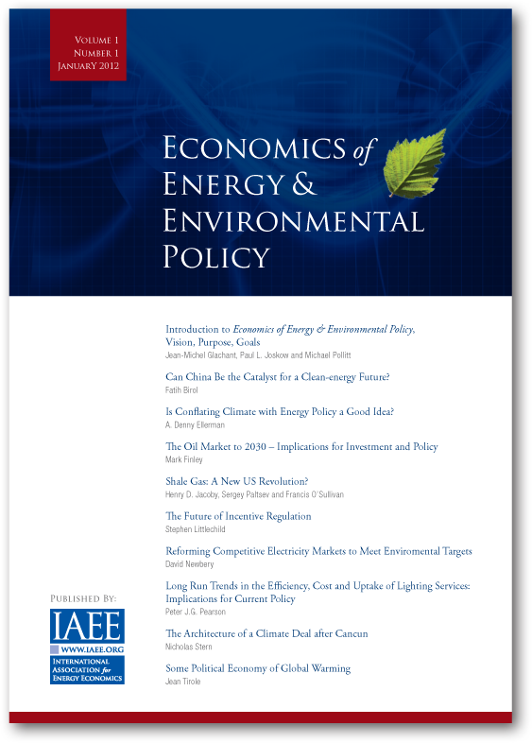
Publications
Notes:
3

Slide 4
European energy transition: Balancing decarbonization goals, energy security, and geopolitical tensions
Norwegian University of Science and Technology
Prof. Dr. Anne Neumann
XIX Conference of the Spanish Association for Energy Economics, 2024 (Granada, Spain)
Based on: Zwickl-Bernhard, S. and A. Neumann (2024): Modeling Europe's role in the global LNG market 2040: Balancing decarbonization goals, energy security, and geopolitical tensions. Energy, 301, 131612.

Slide 5
Sustain-ability
Energy Policy
Afford-ability
Security of supply

Slide 6
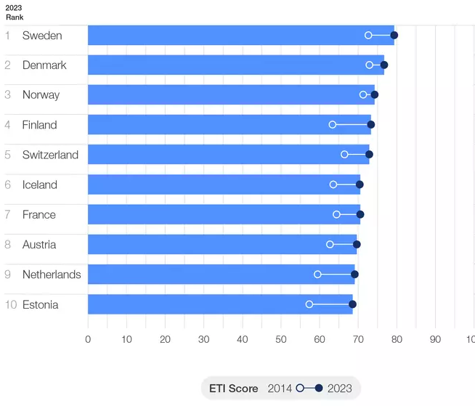
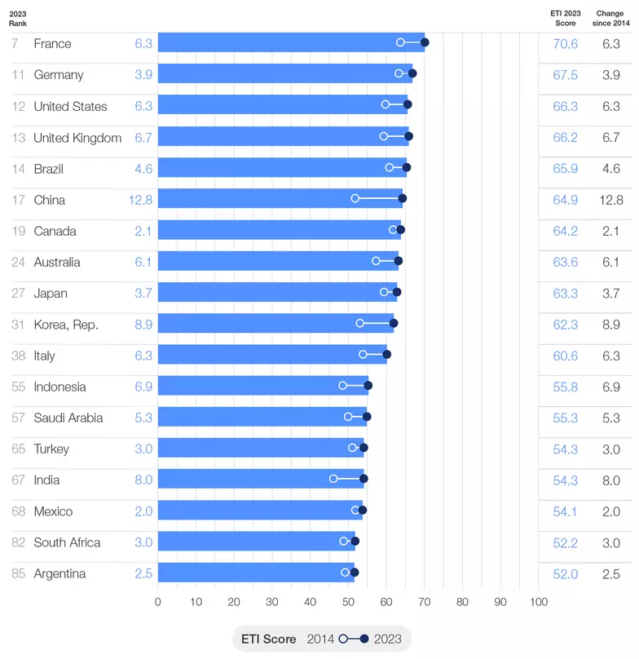
Europe in the world: Energy Transition Index 2023
Top 10 countries
G20 countries
Source: World Economic Forum, 2023
Notes:
- Europe: Clean, secure and affordable
- Globally: at the expense of equity

Slide 7
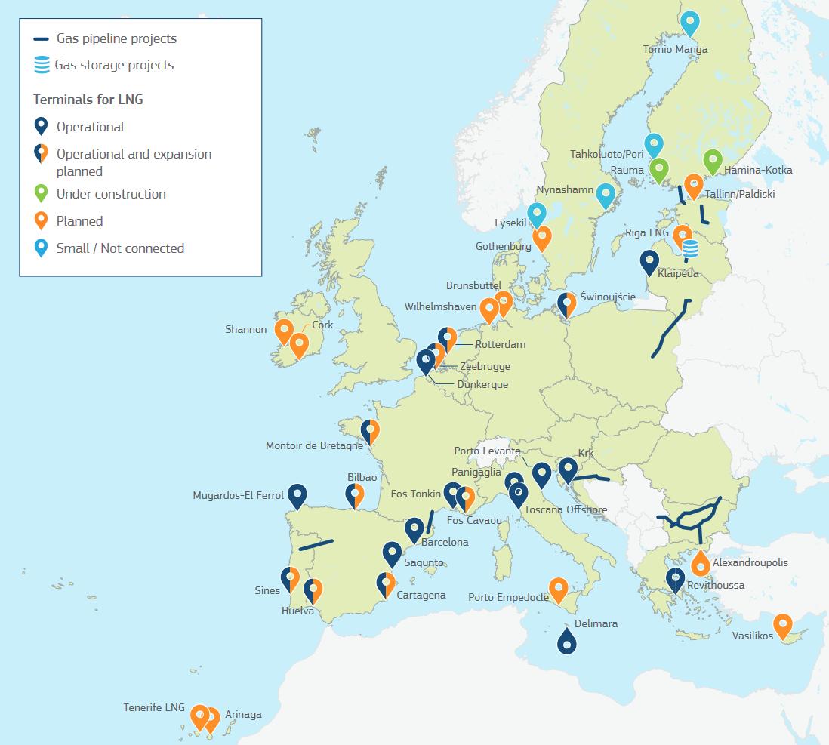
European LNG infrastructure
Source: Factsheet EU-U.S. LNG Trade, EC (2022).

Slide 8
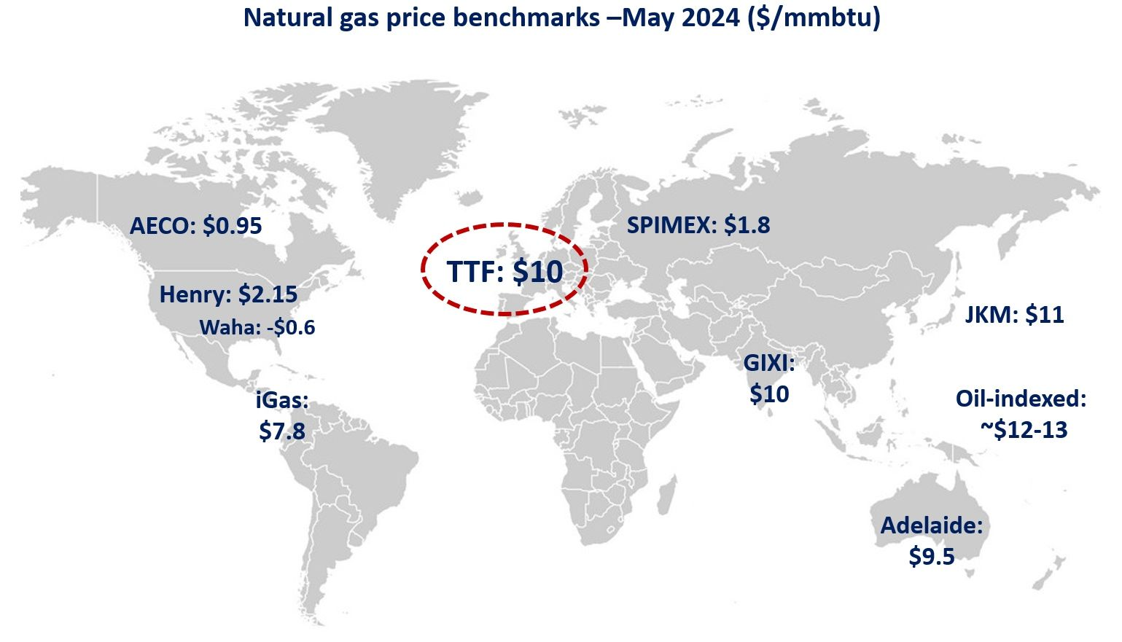
Europe in the global LNG market 2040

Slide 9
Which impact will geopolitical tensions between importing and exporting regions have on European LNG supply if global LNG trade were to be used as a political weapon?

Slide 10
Methodological approach (I)
Focus on European supply and associated costs in 2040 under two scenarios
The impact of political tensions -> detailed analysis of LNG flows and supply costs for five cases
Specifically looking at Europe

Slide 11
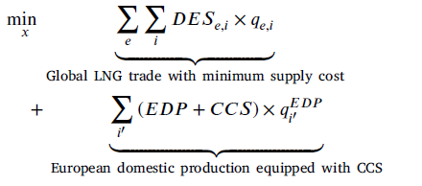
Methodological approach (II)
Tailor-made (and simplified) optimization model
minimizing DES costs + alternative supply
considering increasing LNG demand in developing countries
subject to six (standard) constraints

Slide 12
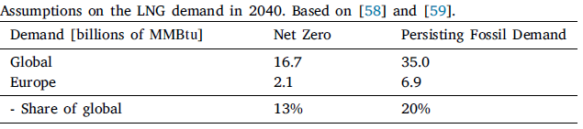
Methodological approach (III)
Assumptions on baseline assumptions for future demand

Slide 13
How will Europe meet its expected LNG demand in 2040 given increased global LNG demand driven primarily by developing countries?
Two possible futures.

Slide 14
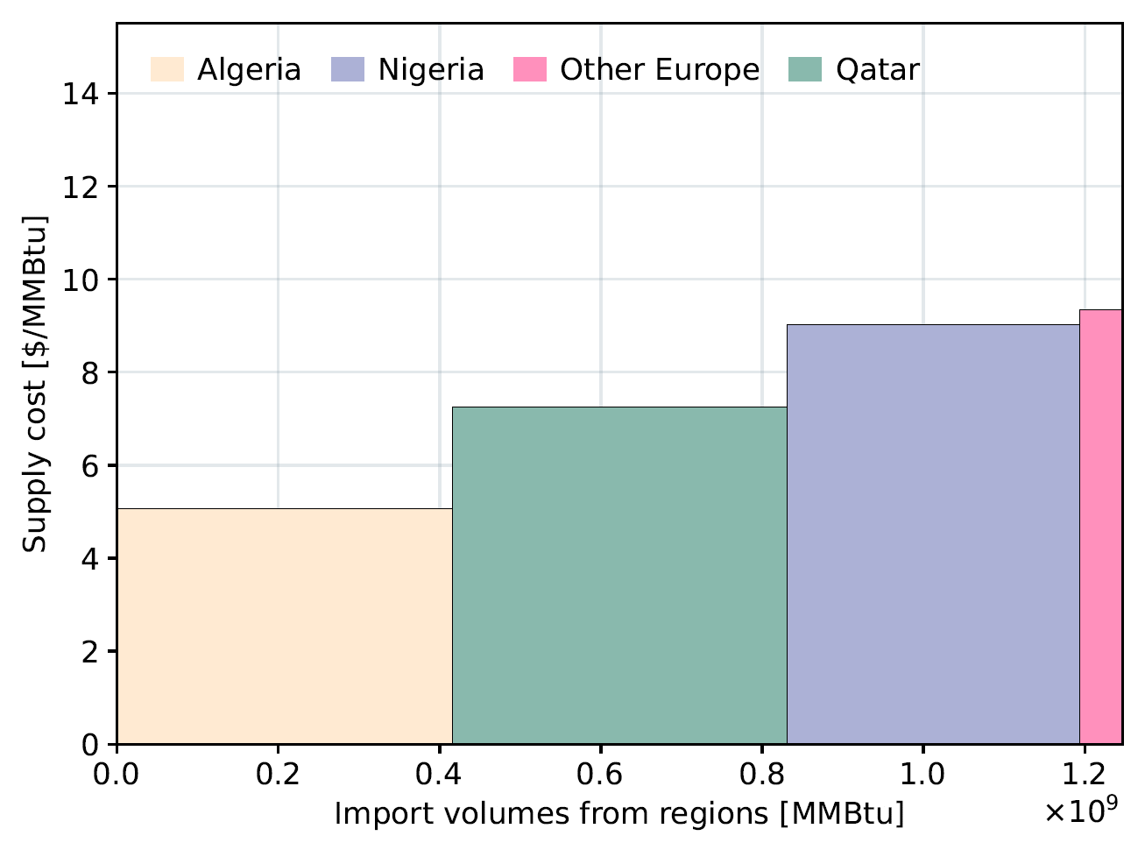
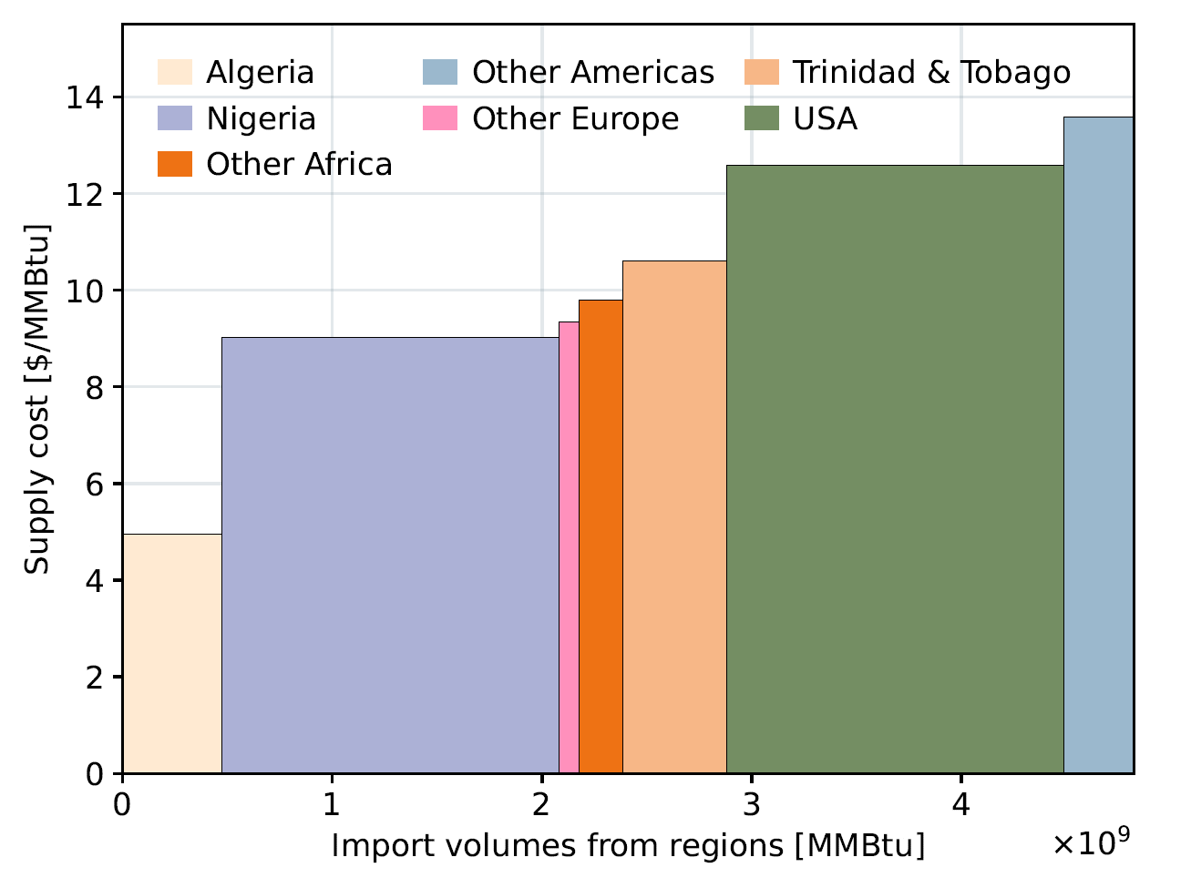
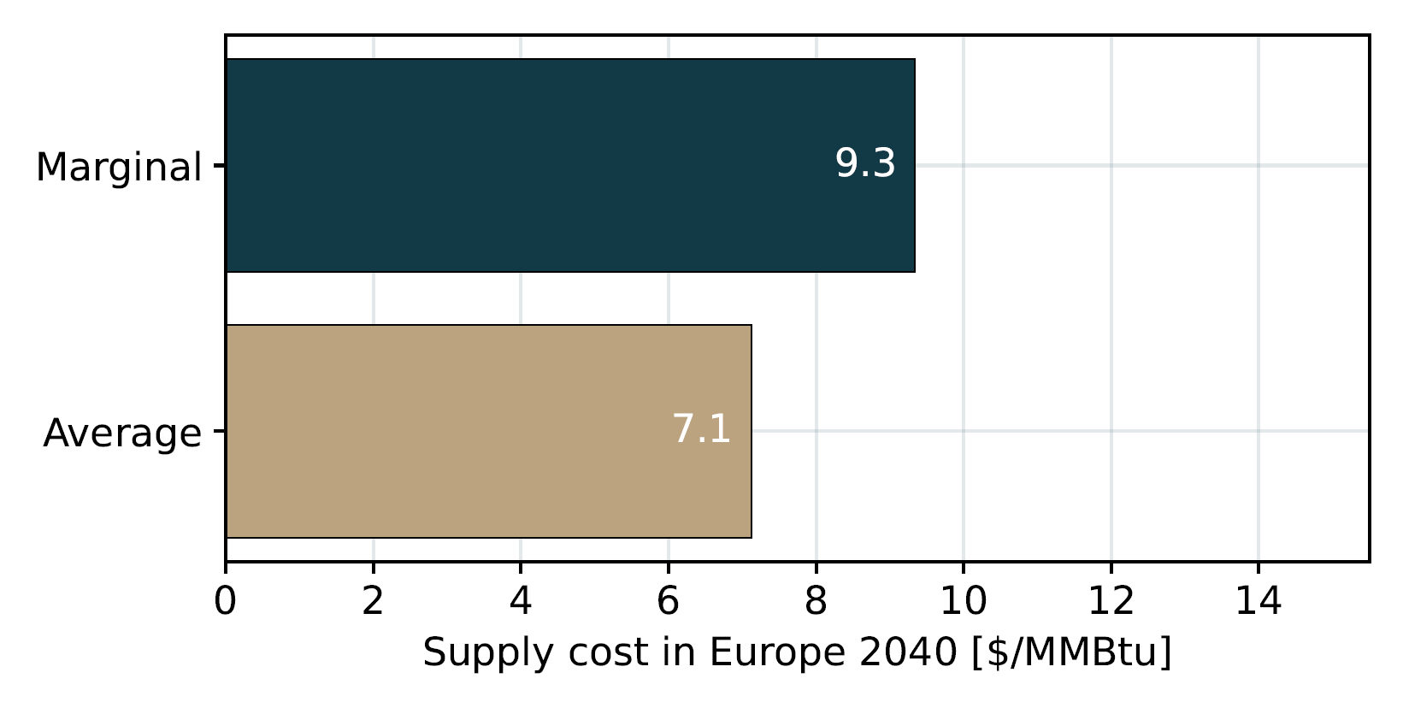
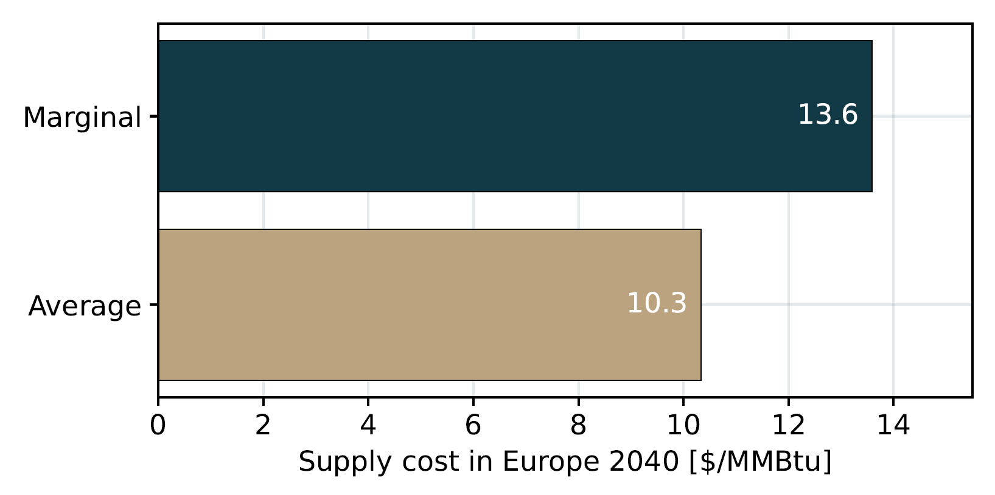
Net Zero Persistent

Slide 15
Which impact will geopolitical tensions between importing and exporting regions have on the European LNG supply if global LNG trade were to be used as a political weapon?

Slide 16
Five cases
Diversify importers
High price Middle East
No exports from Africa
Panama canal restricted
Russian exports to Asia only
Notes:
We assume that Europe follows a strong diversification strategy in regions where LNG is imported from to reduce dependency on specific regions.
This case considers a situation where the delivered ex-ship costs of the Middle East region increase. Compared with the initial values of the two scenarios, the delivered ex-ship costs of Qatar, Oman, and Other Middle East are assumed to increase by +25%. Notably, this particularly affects the costs of three regions that initially have relatively lower delivered ex-ship costs than other export regions. A current example of this case could be that piracy and other attacks along the transport routes of the exporters mentioned (e.g., Houthi attacks around the Bab al- Mandab Strait) increase the chartering and insurance costs of the LNG carriers.
The rapid increase in energy demand in the African continent is assumed to lead to an LNG market where no exports from African regions occur. Put differently, this case considers a situation where African LNG exporters prioritize African energy demand and do not participate in global trade.
This case considers the situation where the Panama canal is restricted. This increases, not only the delivered ex-ship costs of the trades passing through the Panama canal, but also those of all other trades (e.g., due to the scarcity of available LNG carriers). The increase in delivered ex-ship costs is assumed to be +33% for those LNG flows passing through the Panama canal and +15% for all the others. Notably, this case could reflect not only political tensions as a weapon but also the situation where low water levels as a result of climate change limit the number of ships and LNG carriers passing through the canal. This has already been observed in 2023.
In this case, LNG sent from Russia is allowed only to Asian regions. This case takes into account the situation where Russia and Asia (e.g. China and India) intensify their cooperation and thus strengthen their LNG trade.

Slide 17
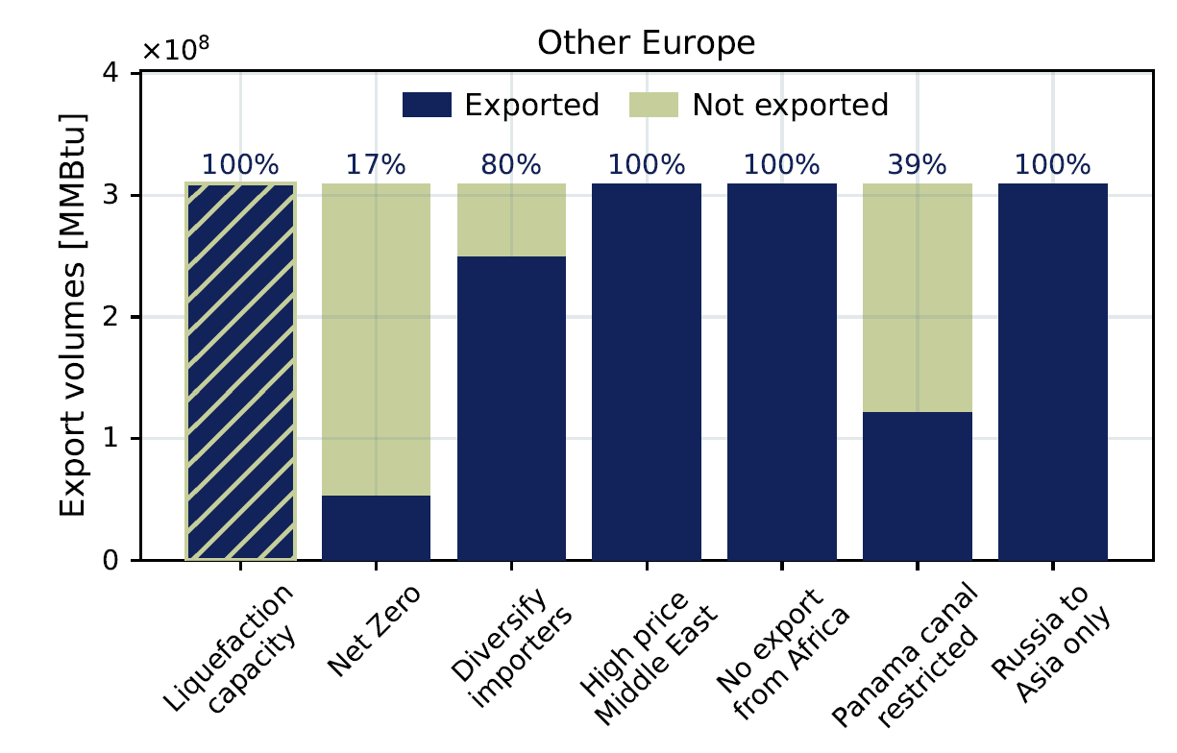
Net Zero, scenario results

Slide 18
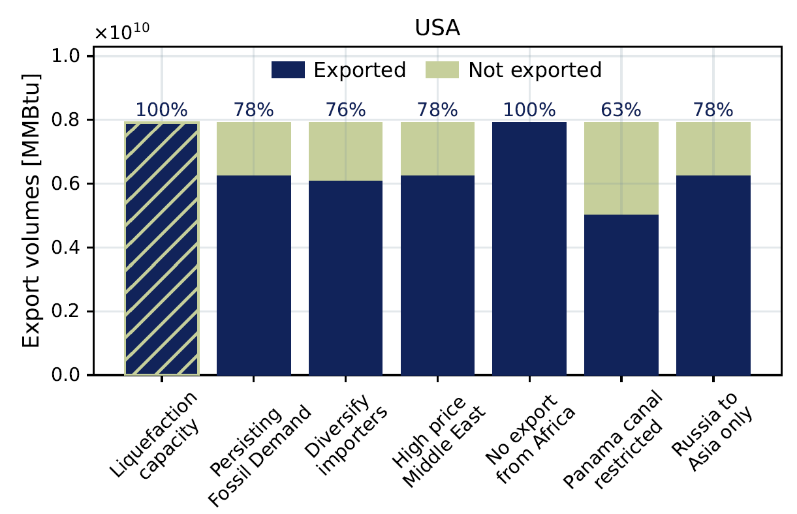
Persistent, scenario results

Slide 19
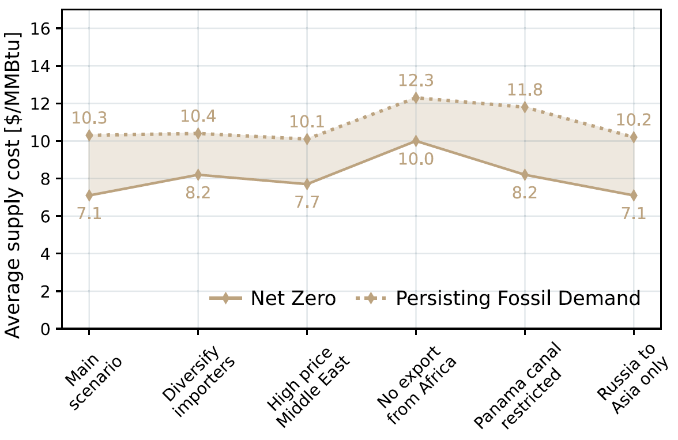
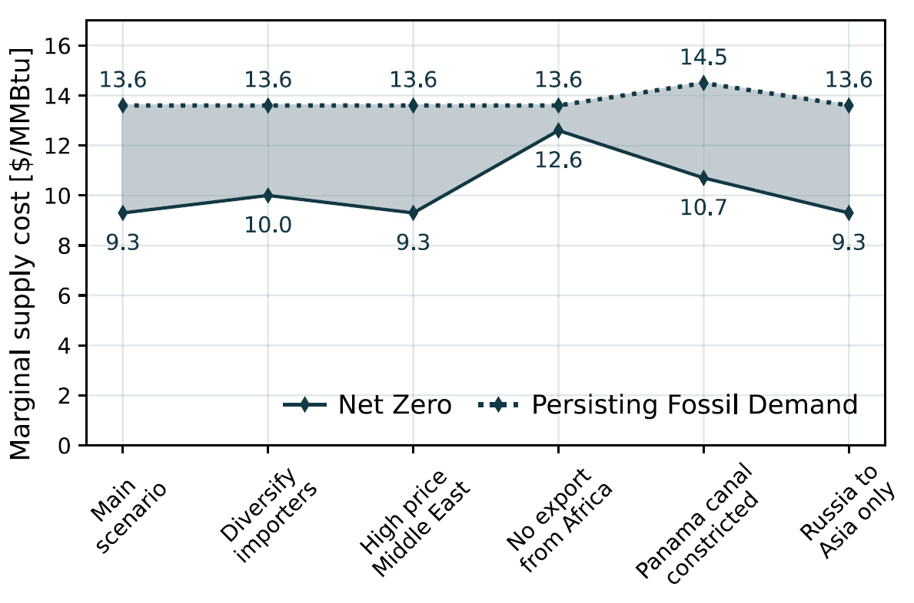
Effect on supply costs
Average supply costs to Europe in 2040
Marginal supply costs to Europe in 2040

Slide 20
Can European domestic fossil gas production combined with CCS be part of the solution for covering the demand in a decarbonized European energy system?

Slide 21
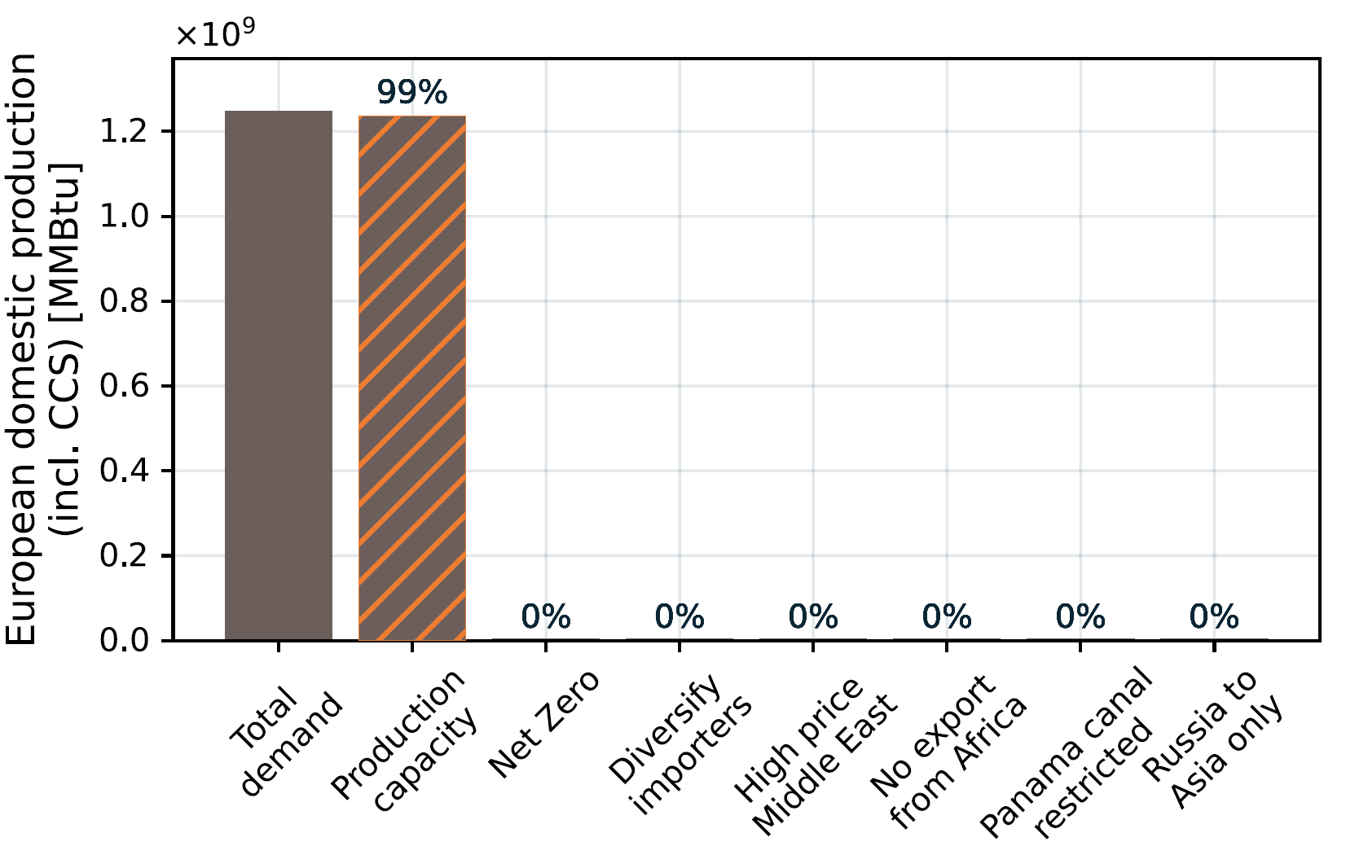
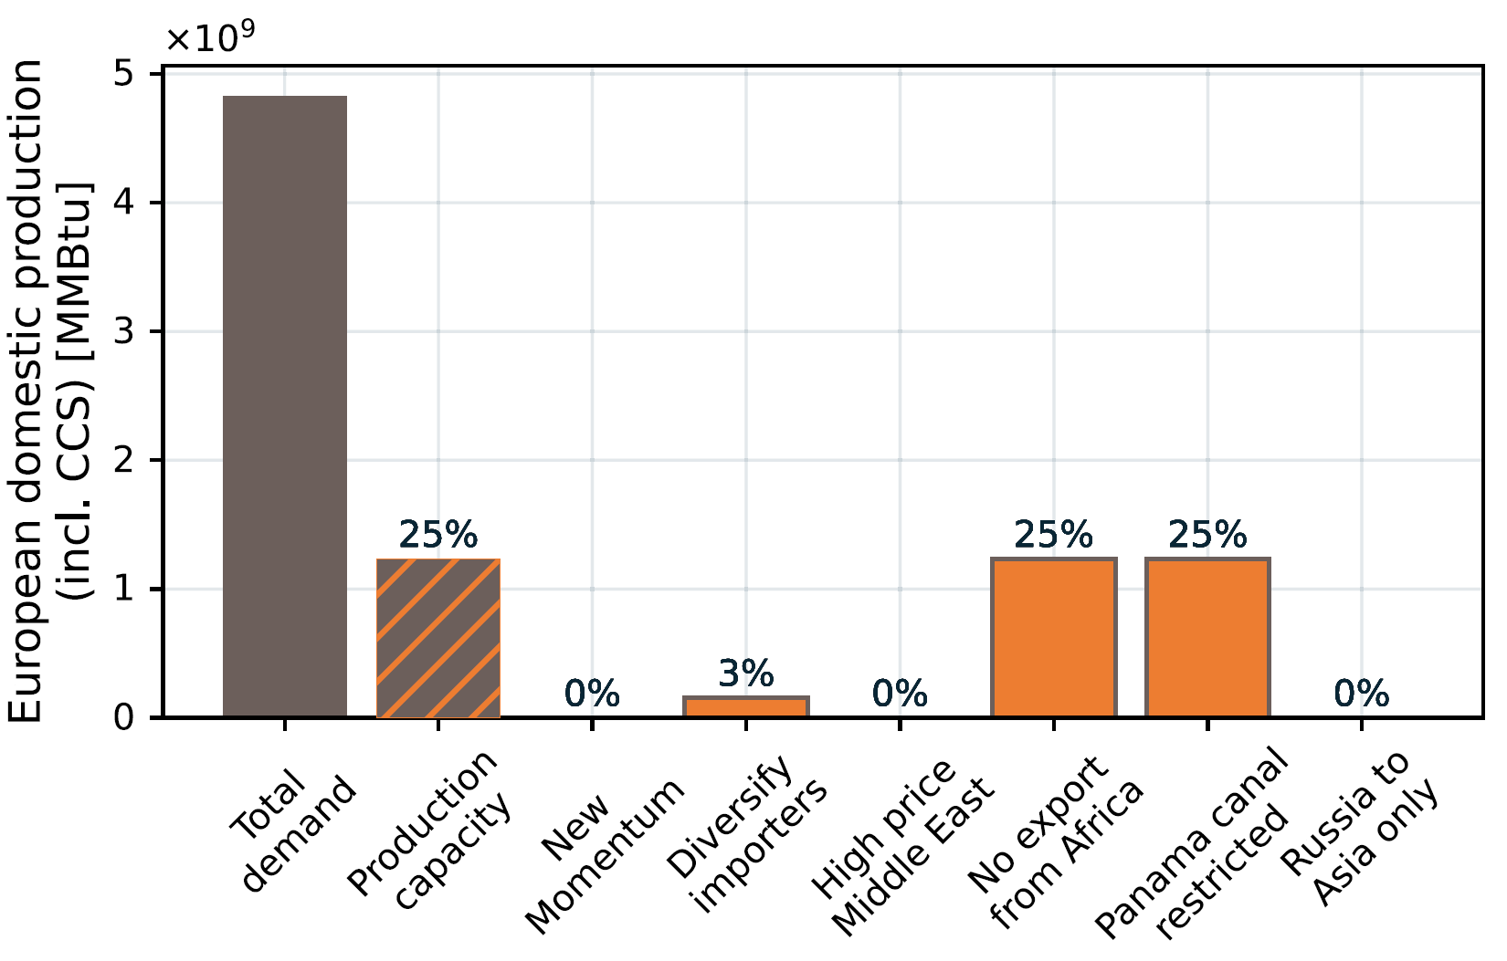
European domestic production with CCS
Net Zero
Persistent

Slide 22
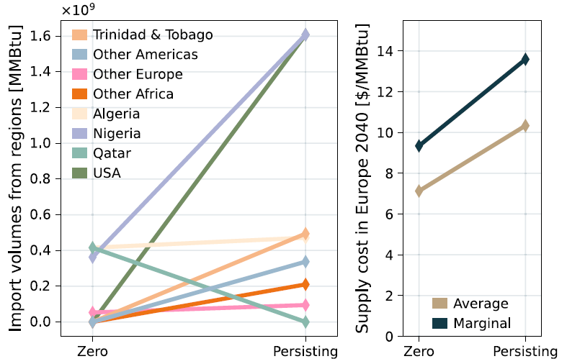
Summary of findings

Slide 23
Conclusion
complexities of Europe’s strategy of simultaneously achieving decarbonization objectives and resolving energy security concerns
provide insights into the economic feasibility and implications of prioritizing domestic production over external LNG imports (CCS)
Europe has a role in the global LNG market only in an ambitious sustainable scenario
African exporters become crucial stabilizers
as global LNG demand rises, genuinely stable trends or patterns in trade decline

Slide 24
Energy Transition can bring …
empowered consumers
competitiveness
new, fast growing industries
jobs
less energy dependency
But needs

Slide 25
… but needs
stable institutions
qualified personell
communication
to be just and inclusive

Slide 26



Time for questions.
Anne Neumann (anne.neumann@ntnu.no)
@anne-f-neumann
0000-0002-5980-9651
[ @anne_f_neumann ]

Slide 27
Back up

Slide 28
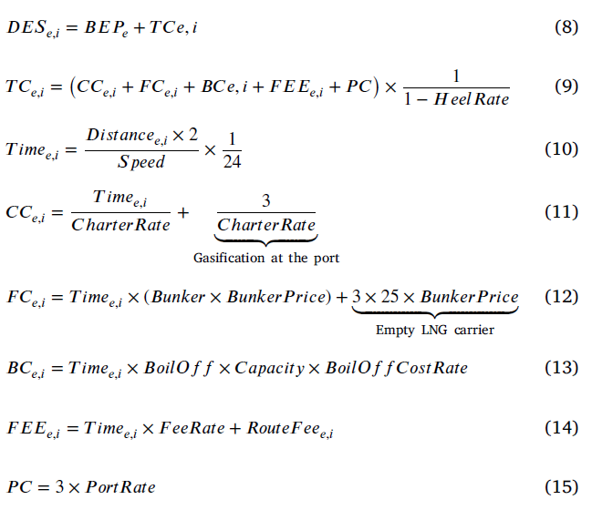
Cost function

Slide 29
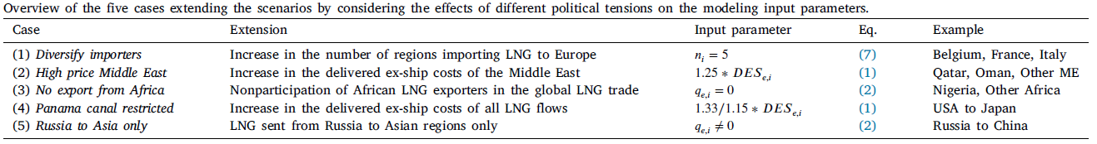
Overview five cases

Slide 30
Scenario effects, Net Zero
 | Diversify imports | High price ME | No exports from Africa | Panama canal closed | Russia to Asia only
Algeria | ↓ |  | ↓↓↓
Nigeria | ↓ | ↑ | ↓↓↓ | ↑ | ↓
Other Africa | ↑↑↑
Other Europe | ↑↑↑ | ↑↑↑ | ↑↑↑ | ↓↓↓ | ↑↑↑
Qatar | ↓ | ↓
T & T |  |  | ↑↑↑
USA |  |  | ↑↑↑

Slide 31
Scenario effects, Persistent
 | Diversify imports | High price ME | No exports from Africa | Panama canal closed | Russia to Asia only
Algeria |  | ↑ | ↓↓↓
Nigeria | ↓ |  | ↓↓↓ | ↓
Other Africa | ↑ | ↓↓↓ | ↓↓↓ | ↓↓↓ | ↑
Other Americas | ↑ |  | ↑ | ↓↓↓ | ↓
Other Europe | ↑ |  | ↑ | ↓↓↓ | ↓↓↓
Qatar |  |  | ↑↑↑
T & T |  |  | ↓ | ↑
USA | ↓

Slide 32
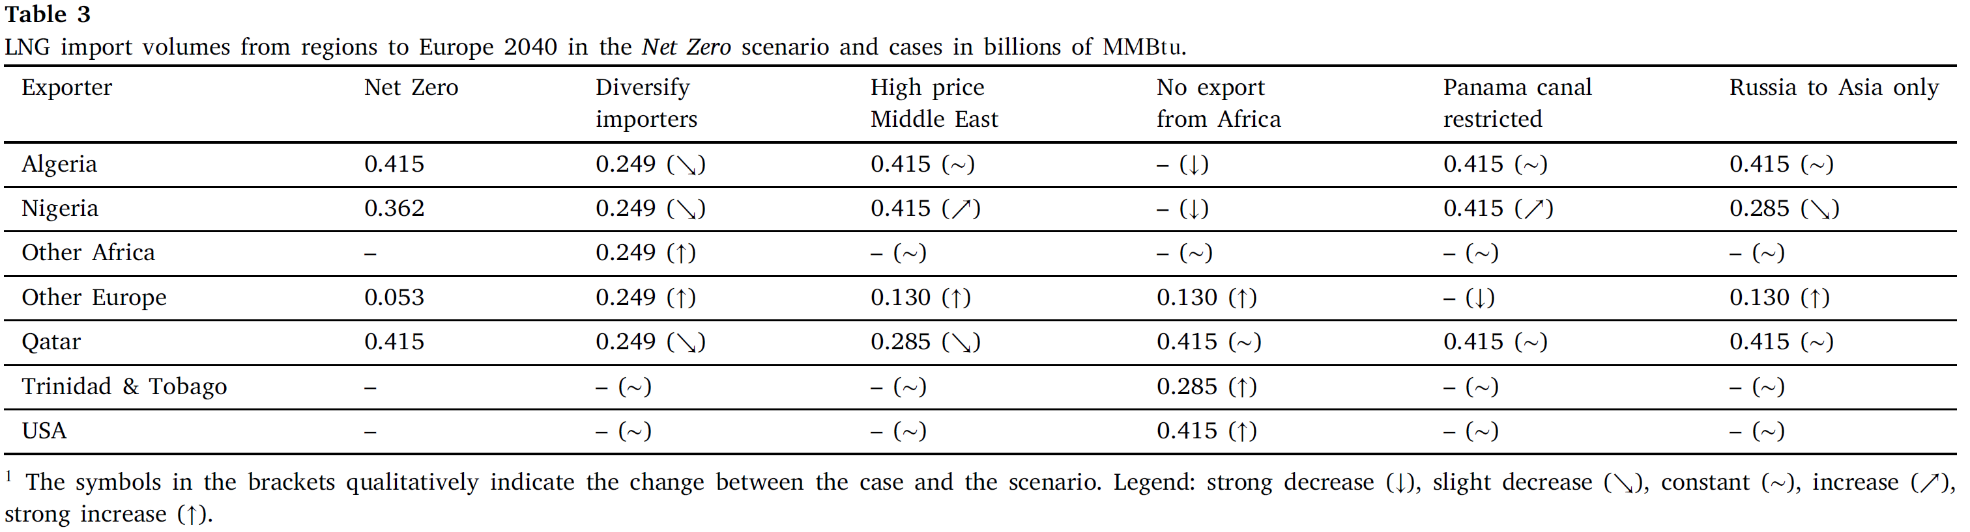

Slide 33
